Slide 1

MEAN & MERN
Presented by :
JNANAVI B A

Slide 2
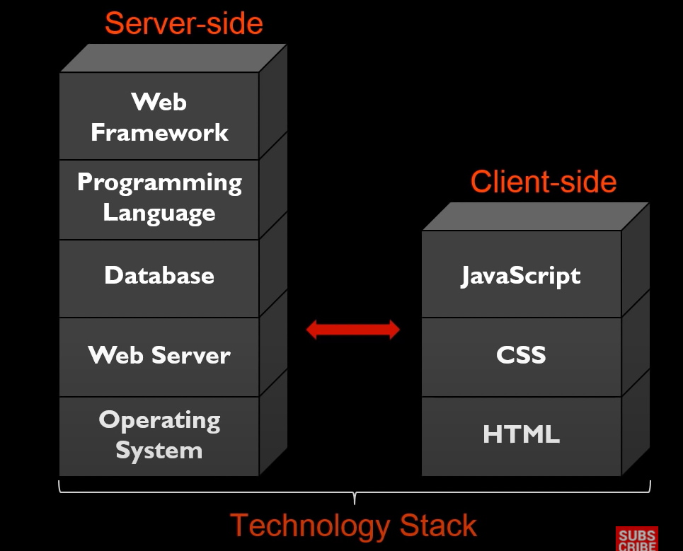
What is a Technology Stack ?
Technology Stack is a combination of frameworks and tools utilized in creating software products.
Technology Stack is composed of both front-end and back-end i.e., the Client-side and the Server-side.

Slide 3




MEAN STACK
MEAN Stack is a open source free JavaScript stack that is used to build dynamic web applications or websites.
MEAN Stack applications can be built using the same programming language both for the Server-side and Client-side applications.
MEAN stands for :
M
E
A
N

Slide 4
MongoDB:
MongoDB is a NoSQL document-oriented database. MongoDB is schema-less and data is stored in flexible documents with a JSON based query language.
2. Express.js:
Express.js is a minimal and flexible Node.js web application framework that provides a robust set of features for web and mobile applications.
3. Angular:
Angular is a platform and framework for building single-page client application using HTML and TypeScript.
4. Node.js:
Node.js is a cross-platform and opensource JavaScript runtime environment that allows the JavaScript to be run on the Server-side.

Slide 5
Benefits of MEAN Stack
You can develop all types of apps easily.
Since the framework is open-source, developers enjoy community support.
A single coding script covers Front-end and Back-end.
Uses JavaScript for both Front-end and Back-end, thus there is an increase in coordination and applications can respond faster
Offers real-time testing with built-in tools.
As it runs on open-source community, its source code can be modified easily.

Slide 6
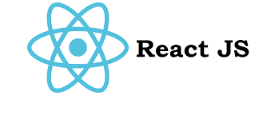
MERN STACK
MERN Stack is another open-source framework that makes development simple and quick.
MERN is the best hybrid web app and mobile app development platform.
MERN stands for:
M
E
R
N

Slide 7
MongoDB:
MongoDB is a NoSQL document-oriented database. MongoDB is schema-less and data is stored in flexible documents with a JSON based query language.
2. Express.js:
Express.js is a minimal and flexible Node.js web application framework that provides a robust set of features for web and mobile applications.
3. React.js:
React is a JavaScript library that builds user interfaces for single-page applications by dividing UI into composable components.
4. Node.js:
Node.js is a cross-platform and opensource JavaScript runtime environment that allows the JavaScript to be run on the Server-side outside the browser.

Slide 8
Benefits of MERN Stack
JavaScript is everywhere. It is used both on the Front-end and Back-end side. Because of this, there’s no need for context switching.
Developers only need to master a single coding language, which makes things million times easier.
Faster Web App Development process.
Efficient Third-party plugins to choose from.
Easy code maintenance.
Flexible architecture.

Slide 9
Similarities between MEAN and MERN
MEAN and MERN both make use of MongoDB, Express.js and Node.js.
Both the MEAN and MERN stacks are easy to implement and flexible.
They are both built using the Model View Controller (MVC) architectural pattern.
Both MEAN and MERN stack has great documentation and community support.
Use JavaScript for both Server-side and Client-side development.

Slide 10
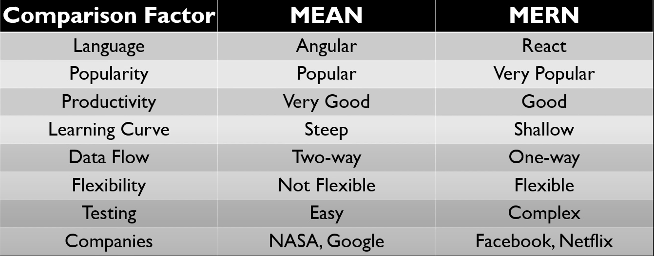
MEAN vs MERN

Slide 11
How to choose the best ?
PROJECT SIZE:
If the size of the project is large it is better to make use of MERN Stack. This is because of the one way data binding property of React.js that will allow efficient execution.
PRODUCTIVITY:
If the project priority is productivity MEAN Stack serves better as Angular is a complete framework whereas React.js is just a library.
MOBILE APPLICATIONS:
MERN Stack is a better choice as React.js offers better user experience.
ERROR-FREE CODE:
MEAN Stack is better choice as Angular by design prevents coding errors.

Slide 12
CONCLUSION
In conclusion, the MEAN and MERN stacks represent two powerful and versatile technology stacks for building modern web applications.
Both stacks emphasize JavaScript throughout the development process, enabling seamless and efficient workflow. Ultimately, the choice between MEAN and MERN depends on specific project requirements and developer preferences. Both the stacks provide the means to create robust, scalable, and dynamic web applications.

Slide 13
THANK YOU

